Slide 1
4
INTEGRALS
Copyright © Cengage Learning. All rights reserved.

Slide 2
4.7
Trigonometric Integrals
Copyright © Cengage Learning. All rights reserved.

Slide 3
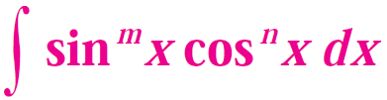

Trigonometric Integrals
Here we use trigonometric identities to integrate certain combinations of trigonometric functions. We start with powers of sine and cosine .
In general, we try to write an integrand involving powers of sine and cosine in a form where we have only one sine factor (and the remainder of the expression in terms of cosine) or only one cosine factor (and the remainder of the expression in terms of sine).
The identity enables us to convert back and forth between even powers of sine and cosine.

Slide 4
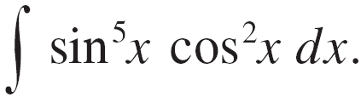



Example 2
Find
Solution:
We could convert to but we would be left with an expression in terms of sin x with no extra cos x factor.
Instead, we separate a single sine factor and rewrite the remaining factor in terms of cos x:

Slide 5
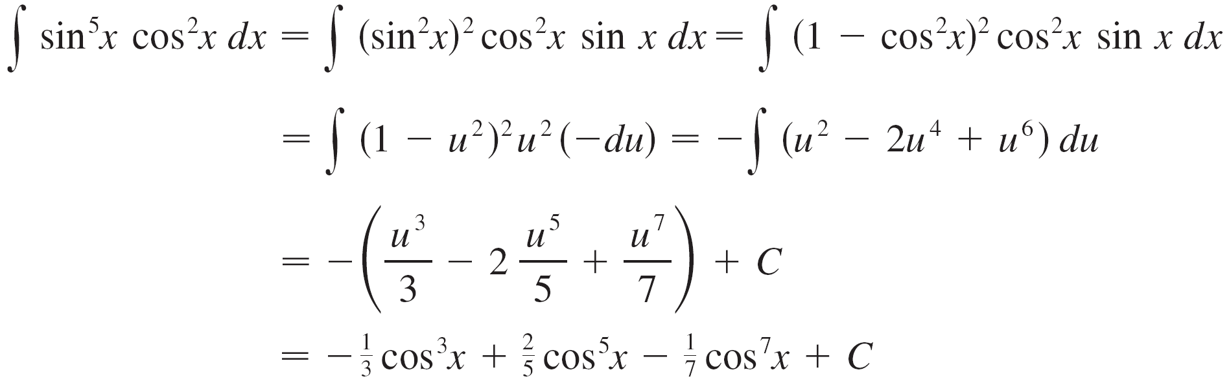
Example 2 – Solution
cont’d
Substituting u = cos x, we have du = –sin x dx and so

Slide 6
Example 2 – Solution
cont’d

Slide 7


Trigonometric Integrals
If the integrand contains even powers of both sine and cosine, this strategy fails.
In this case, we can take advantage of the following
half-angle identities (see Equations 17b and 17a in
Appendix A):
and

Slide 8
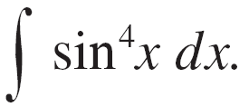

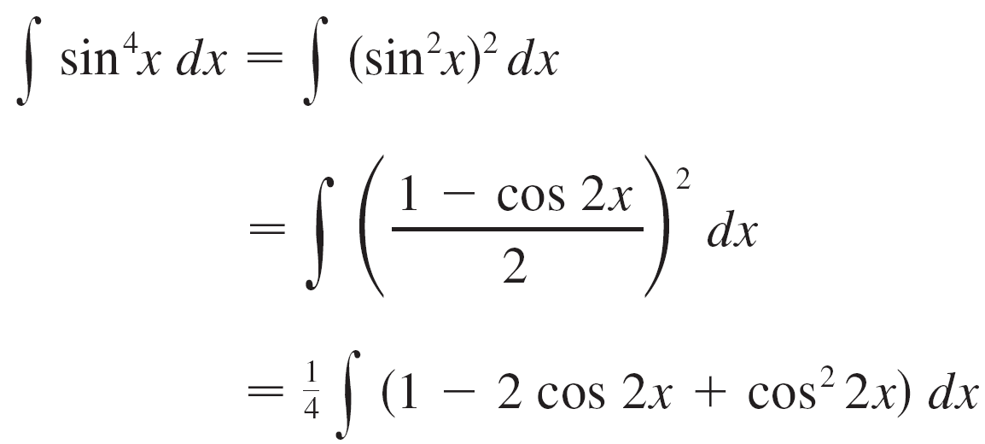
Example 4
Find
Solution:
We evaluate this integral by writing and using the half-angle formula :

Slide 9

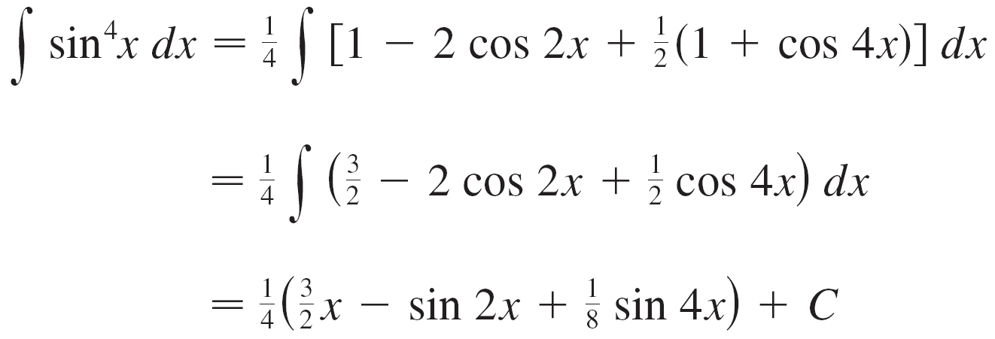
Example 4 – Solution
cont’d
Since cos²2 x occurs, we must use another half-angle formula
This gives

Slide 10
Example 4 – Solution
cont’d

Slide 11

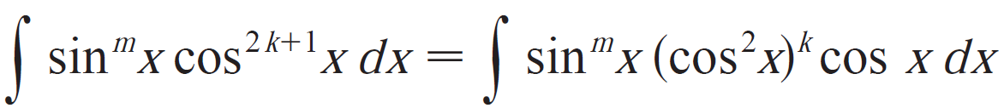
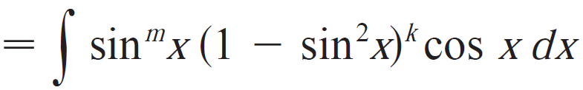


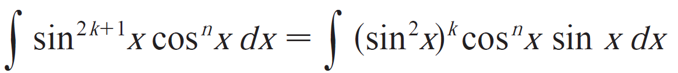
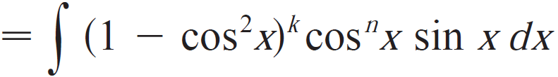

Trigonometric Integrals
Strategy for evaluating
If the power of cosine is odd (n=2k+1), save one cosine factor and use to express the remain factors in terms of sine:
Then substitute
(b) If the power of sine is odd (m=2k+1), save one cosine factor and use to express the remain factors in terms of cosine:
Then substitute
Note: if the powers of both sine and cosine are odd, either (a) or (b) can be used.

Slide 12



Trigonometric Integrals
Strategy for evaluating
(c) If the power of both sine and cosine are even, use the half-angle identities
It is sometimes help to use the indentity

Slide 13



Trigonometric Integrals
We can use a similar strategy to evaluate integrals of the form
Since we can separate a sec²x factor and convert the remaining (even) power of secant to an expression involving tangent using the identity
Or, since we can separate a sec x tan x factor and convert the remaining (even) power of tangent to secant.

Slide 14


Example 6
Find
Solution:
If we separate a sec²θ factor, as in the preceding example, we are left with a sec⁵θ factor, which isn’t easily converted to tangent.
However, if we separate a sec θ tan θ factor, we can convert the remaining power of tangent to an expression involving only secant using the identity

Slide 15
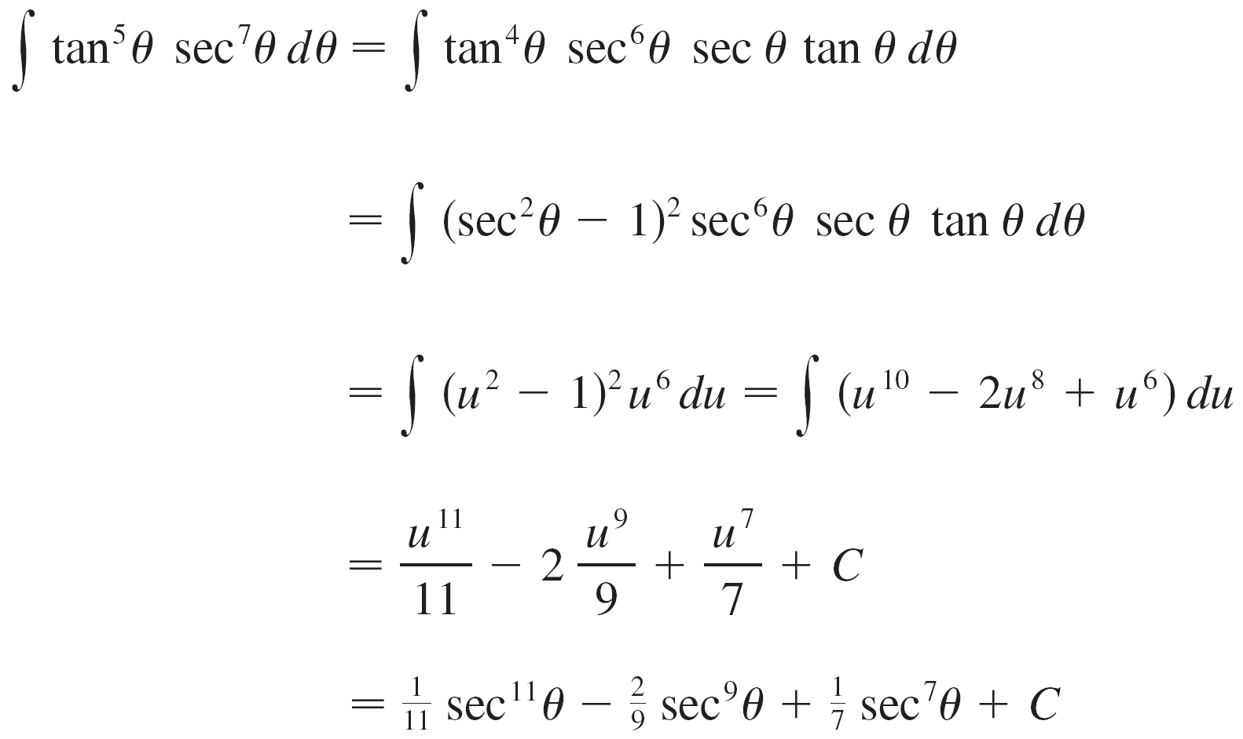
Example 6 – Solution
cont’d
We can then evaluate the integral by substituting u = sec θ, so du = sec θ tan θ dθ :

Slide 16
Example 6 – Solution
cont’d

Slide 17
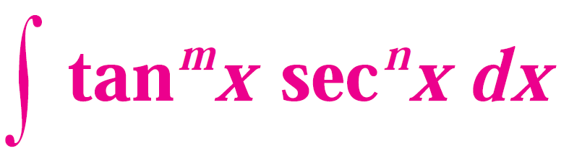


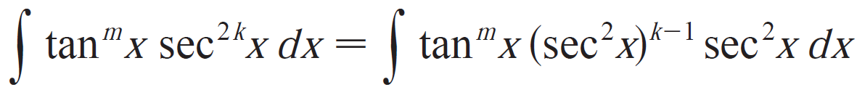
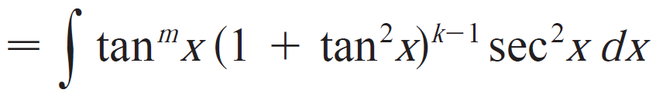



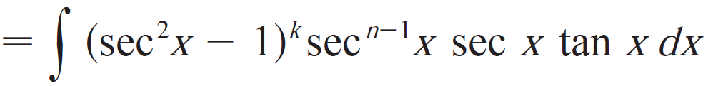

Trigonometric Integrals
Strategy for evaluating
If the power of secant is even (n=2k,k>=2), save one cosine factor of and use to express the remain factors in terms of tan x:
Then substitute
If the power of tangent is odd (m=2k+1), save one cosine factor of
and use to express the remain factors in terms of sec x:
Then substitute

Slide 18
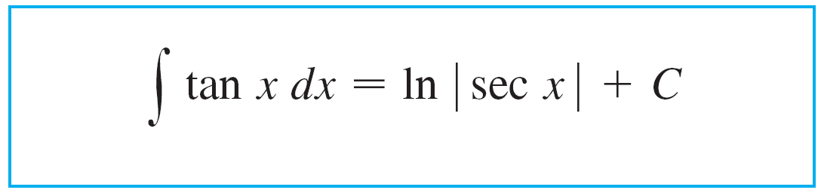
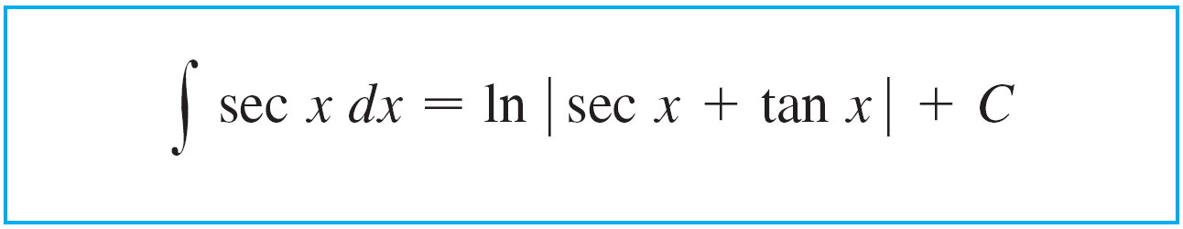

Trigonometric Integrals
For other cases, the guidelines are not as clear-cut. We may need to use identities, integration by parts, and occasionally a little ingenuity.
We will sometimes need to be able to integrate tan x:
We will also need the indefinite integral of secant:

Slide 19
Trigonometric Integrals
If an even power of tangent appears with an odd power of secant, it is helpful to express the integrand completely in terms of sec x.
Powers of sec x may require integration by parts, as shown in the next example.

Slide 20
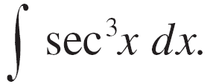
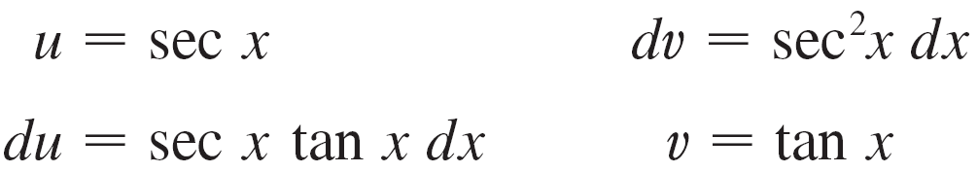
Example 8
Find
Solution:
Here we integrate by parts with
Then

Slide 21
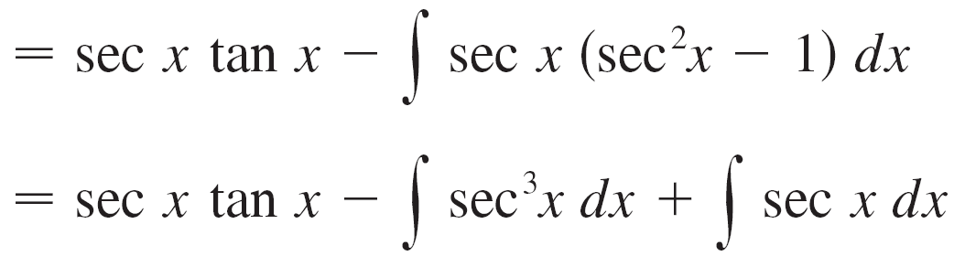
Example 8 – Solution
cont’d
Using Formula 1 and solving for the required integral, we get

Slide 22
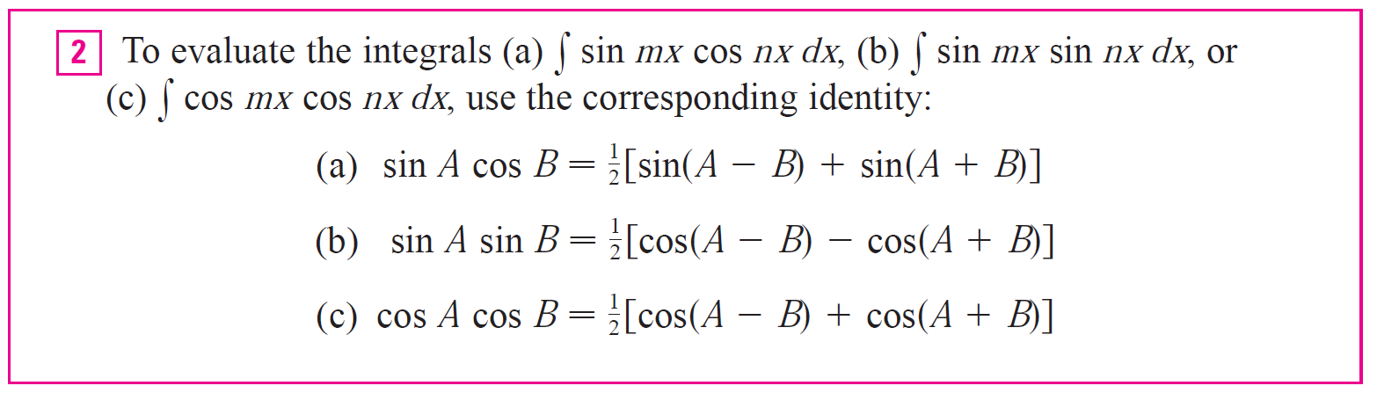
Trigonometric Integrals
Strategy to evaluate the integrals:

Slide 23
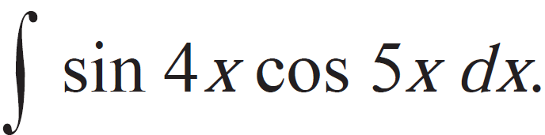
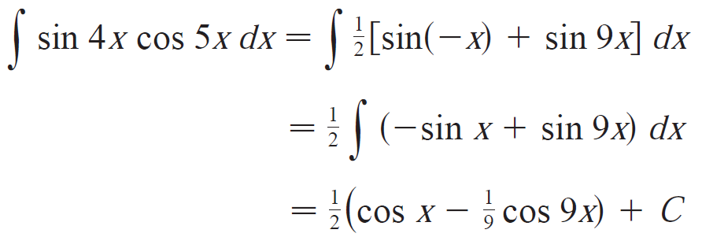
Example 8
Evaluate
Solution:
This integral can be evaluated using integration by parts, but it is easier to use the identity in Eqn. 2(a) as follows:

